Slide 1
The Design Model

Slide 2
Design Model Elements
Data elements
  Data model --> data structures
  Data model --> database architecture
Architectural elements
  Application domain
  Analysis classes, their relationships, collaborations and behaviors are transformed into design realizations
  Patterns and “styles” (Chapters 9 and 12)
Interface elements
  the user interface (UI)
  external interfaces to other systems, devices, networks or other producers or consumers of information
  internal interfaces between various design components.
Component elements
Deployment elements
These slides are designed to accompany Software Engineering: A Practitioner’s Approach, 7/e (McGraw-Hill, 2009) Slides copyright 2009 by Roger Pressman.

Slide 3
Data Design Elements
Creates a model of data represented at a higher level of abstraction
Users/customers’ view of data
After that refined to more implementation-specific representation that can be processed by the system
Data architecture has an impact on software architecture (as an effective design may lead to efficient processing)
Data elements are important because the translation of data model to the database at the application level is an integral part of the design
Moreover, efficient data storage may result in a data warehousing
That may lead to data mining or knowledge discovery via insights’ extraction which has an impact on business success
These slides are designed to accompany Software Engineering: A Practitioner’s Approach, 7/e (McGraw-Hill, 2009) Slides copyright 2009 by Roger Pressman.

Slide 4
Architectural Design Elements
As a house floor plan contains all the details, likewise the architectural design shows the overall view of the software system.
Architectural model is derived from:
  Information about the application domain for which the software is being built
  Requirement elements like dataflow diagrams, relationship or collaboration diagrams
  The availability of architectural styles (e.g., data-centered arch. , OO arch, layered architectures)
Usually depicted as a set of interconnected subsystems
Which are derived from work packages of the requirements
Each subsystem may have its own architecture design
These slides are designed to accompany Software Engineering: A Practitioner’s Approach, 7/e (McGraw-Hill, 2009) Slides copyright 2009 by Roger Pressman.

Slide 5
Interface Elements
As detailed drawings show the inner view of the plan
likewise, the interface elements show the information flows into and out of the system. And how that information is communicated among system modules.
3 important elements of interface design are:
  UI design (for managers)
  External interface to other devices/components/consumers
  Internal interfaces between various components (different screens in a module)
Tools like adobe Xd, Figma, etc. could be used
It encompasses:
  the aesthetic elements(layout , color scheme, visuals)
  Ergonomic elements (UI navigation, information placement)
These slides are designed to accompany Software Engineering: A Practitioner’s Approach, 7/e (McGraw-Hill, 2009) Slides copyright 2009 by Roger Pressman.

Slide 6
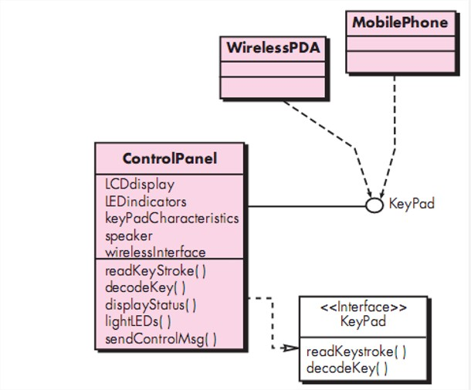
Interface Elements
External interface design must incorporate input validation and security.
Interfaces could be modeled as the external visualizers of public operations of class without showing the internal implementation details.
These slides are designed to accompany Software Engineering: A Practitioner’s Approach, 7/e (McGraw-Hill, 2009) Slides copyright 2009 by Roger Pressman.

Slide 7
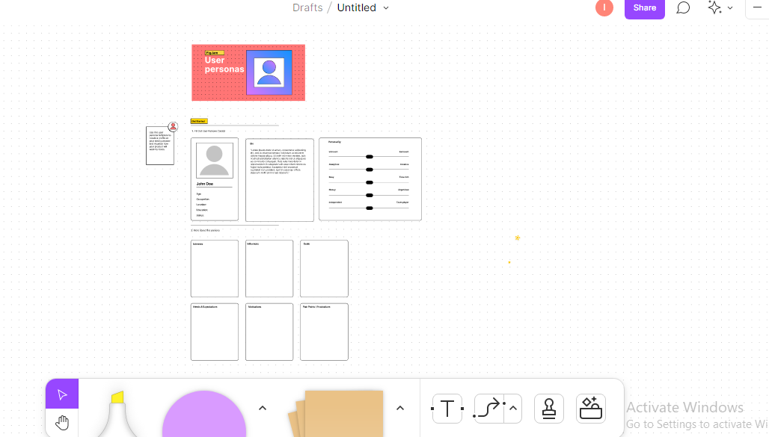
Interface Elements
Credits: Figma.com (UI design tool)

Slide 8
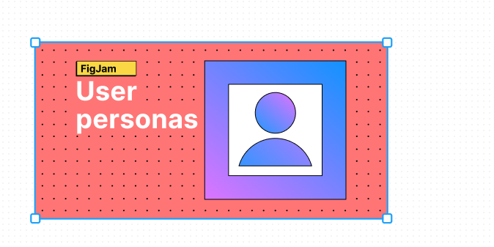
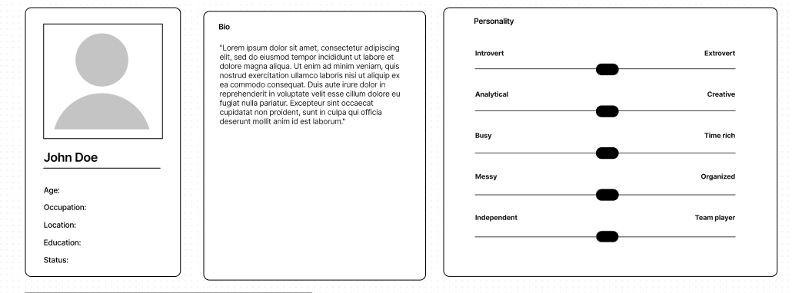
Interface Elements
Credits: Figma.com (UI design tool)

Slide 9
Component Elements
In software design component design is equivalent to a set of detailed drawings for a room.
Describes internal details of a software component
It defines :
  Data structures for all local data objects (depends on nature of the object)
  Algorithmic details of the process occurs in a component (shown using activity diag. / flowcharts/pseudocode)
  Interface which allows access to all component operations
These slides are designed to accompany Software Engineering: A Practitioner’s Approach, 7/e (McGraw-Hill, 2009) Slides copyright 2009 by Roger Pressman.

Slide 10
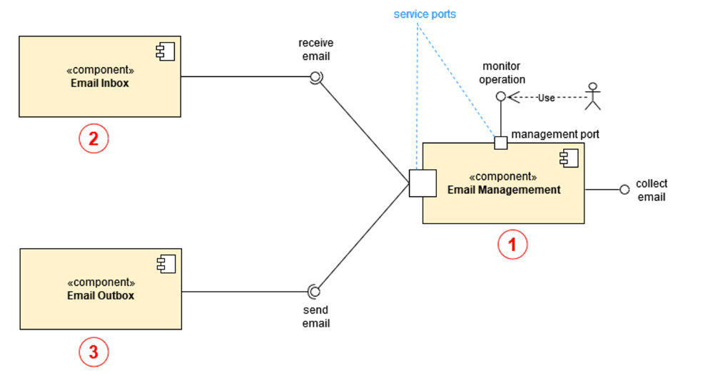

Component Elements
External interface
Assembly connectors
These slides are designed to accompany Software Engineering: A Practitioner’s Approach, 7/e (McGraw-Hill, 2009) Slides copyright 2009 by Roger Pressman.

Slide 11
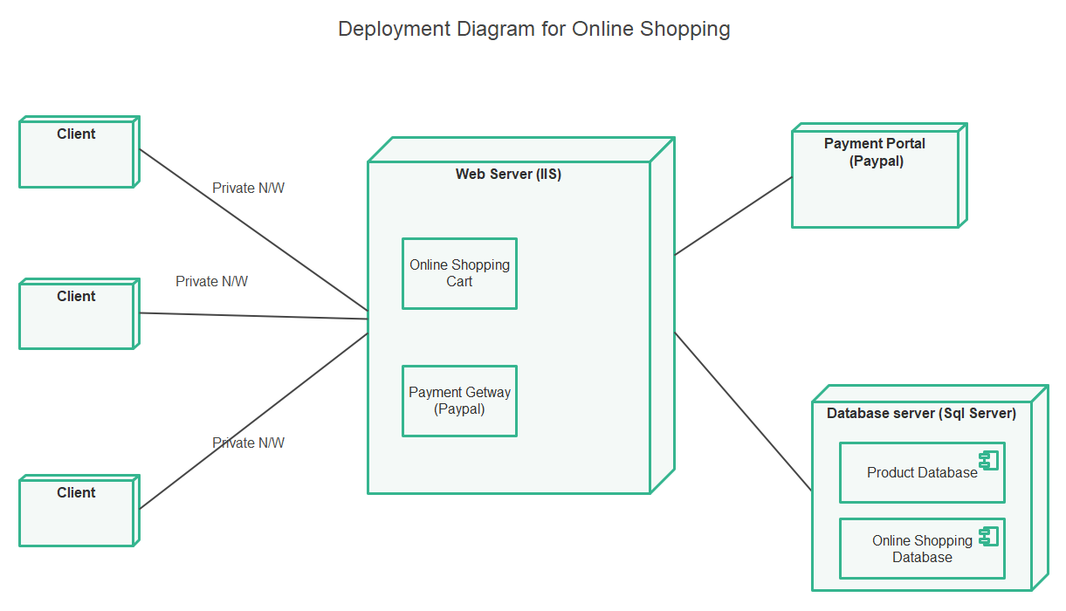
Deployment Elements
Shows what are the physical computing environment in which the software functionality and the subsystems operate.
These slides are designed to accompany Software Engineering: A Practitioner’s Approach, 7/e (McGraw-Hill, 2009) Slides copyright 2009 by Roger Pressman.

